Slide 1
Data Analysis (III):
Statistical Tests and Communicating Findings
Mohamed Albirair, MBBS, MPH, PhD
Jan 2026

Slide 2
Today’s Outline
Brief Revision
Hypothesis Testing and Statistical Tests
Communicating Evidence:
  Statistical Output Interpretation
  Visualization of Evidence

Slide 3
1 | Brief Revision

Slide 4
Types of Data in
Quantitative Research
Categorical
Nominal
(gender, marital status, race)
Ordinal
(severity scale, good/better/best)
Numerical
Discrete
(number of children in a family)
Continuous
(height, weight, cholesterol level)

Slide 5



Types of Data Analysis by
Purpose of the Analysis
Mathematics
Statistics
Descriptive
Comparative
Inferential
Describe summaries of every variable individually
Explore associations in the sample only, with no further interpretation
Make judgements on the source popoulation based on the sample

Slide 6


Types of Data Analysis by
Number of Variables
Univariate
Bivariate
Multivariate
Only one variable.
Find summaries.
e.g., age
Describe/explore relationship between 2 variables
e.g., relationship between age and weight
Describe/explore relationship between 3 variables or more
e.g., relationship between age and weight stratified by sex (and/or race… etc.)

Slide 7
Types of Data vs. Types of Analysis
 | Categorical | Numerical
Descriptive | ? | ?
Comparative | ? | ?
Inferential | ? | ?

Slide 8













Population
Sample
Sampling
Inferencing

Slide 9


Population
Sample
Sampling
Mean, median, standard deviation,
Odds ratio… etc.
Inference
Descriptive/ Comparative analysis
Notes:
Sample of 50, compare the weights of boys and girls

Slide 10

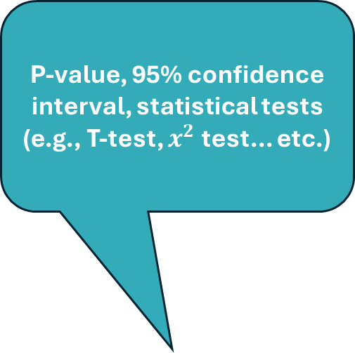
Population
Sample
Sampling
P-value, 95% confidence interval, statistical tests (e.g., T-test, $x^{2}$ test... etc.)
Inference
Inferential analysis
Notes:
التحليل الاستنباطي

Slide 11
Comparative Analysis
Measures of Association
“Effect Size”
Bi-/Multivariate Analysis
Descriptive Analysis
Measures of Occurrence
Univariate Analysis
RR
OR
RD/AR
Regression
Uncertainty Estimates
Mean (SD)
Median (IQR)
Categorical Data
Numerical Data
Counts and proportions
Prevalence
Incidence
Numerical Data
Correlation
Linear Slope
$$y=a+bx$$
Regression
Correlation
Linear Slope
𝑦=𝑎+𝑏𝑥
Regression
Categorical Data
Linear Regression
X² Test
Logistic Regression
Categorical Data
Numerical Data
Numerical and Categorical Data
Compare group means or medians
Regression
Numerical and Categorical
T-Test
M/ANOVA
Wilcoxon
Regression
Exploratory Data Analysis (EDA)
Point Estimates
Inferential Analysis
Statistical Tests
Bi-/Multivariate Analysis

Slide 12
Types of Research Questions vs.
Types of Analyses
Research question | Association | Descriptive | Comparative | Inferential
What is the average height of 6th grade students? | × | ✓ | × | ?
What is the male/female distribution of admitted patients? | × | ✓ | × | ?
What is the distribution of educational level? | × | ✓ | × | ?
Do smokers have higher lung cancer incidence? | ✓ | × | ✓ | ?
Is the risk of smoking-associated lung cancer higher among males or females? | ✓ | × | ✓ | ?

Slide 13
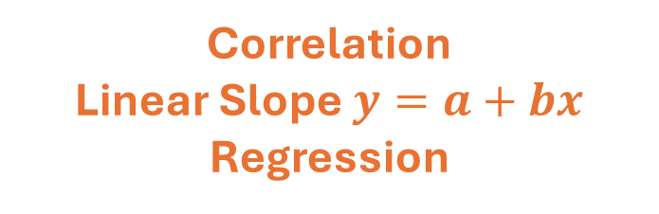
Measures of Association
Categorical
Numerical
RR
OR
RD/AR
Regression
Compare group means or medians
Regression
Categorical
Compare group means or medians
Regression
Correlation
Linear Slope $y=a+bx$
Regression
Numerical

Slide 14
Statistical Tests
Categorical
Numerical
T-Test
M/ANOVA
Wilcoxon
Regression
Categorical
X² Test
Logistic Regression
T-Test
M/ANOVA
Wilcoxon
Regression
Numerical
Linear Regression

Slide 15
Bi-/Multivariate Data Visualization
Categorical
Numerical
Boxplot
Bar plot
2 histograms
Categorical
Cross-Tabulation
Bar plot
Boxplot
Bar plot
2 histograms
Numerical
Scatterplot
Line chart

Slide 16
2 | Hypothesis Testing and Statistica Tests

Slide 17
Hypothesis Testing and Statistical Tests
Are used to evaluate whether findings in a sample apply to the source population (where the sample came from)
  Not part of descriptive analysis or comparative per se, only inferential!
Assume that a sample is representative of the source population.
  If not, they are meaningless!
Involve assessing the probability of observing those findings under “counterfactual” assumptions

Slide 18
Hypothesis Testing—Conceptualization
Example finding: males SBP > females SBP [in a sample], e.g.
  For example, 5-unit points on average [in a sample]
Assume (hypothesis): males and females are not different in SBP.
Create a normal distribution of the SBP difference.
  Should be centered at 0
Decide a statistical significance threshold level (typically, 95%).
Calculate the probability of a 5-unit SBP difference or more under than distribution.
If that probability is <5%, then this is significant and violates your primary assumption (hypothesis), thereby supporting your finding.

Slide 19
Comparative Analysis
Measures of Association
“Effect Size”
Bi-/Multivariate Analysis
Descriptive Analysis
Measures of Occurrence
Univariate Analysis
RR
OR
RD/AR
Regression
Uncertainty Estimates
Mean (SD)
Median (IQR)
Categorical Data
Numerical Data
Counts and proportions
Prevalence
Incidence
Numerical Data
Correlation
Linear Slope
$$y=a+bx$$
Regression
Correlation
Linear Slope
𝑦=𝑎+𝑏𝑥
Regression
Categorical Data
Linear Regression
X² Test
Logistic Regression
Categorical Data
Numerical Data
Numerical and Categorical Data
Compare group means or medians
Regression
Numerical and Categorical
T-Test
M/ANOVA
Wilcoxon
Regression
Exploratory Data Analysis (EDA)
Point Estimates
Inferential Analysis
Statistical Tests
Bi-/Multivariate Analysis

Slide 20
3 | Interpreting Statistical Analysis Outputs

Slide 21
Motivating Example #1
Study [link]:
Overweight, obesity, and mortality from cancer in a prospectively studied cohort of U.S. adults
Questions:
Is there an association between obesity and the listed cancer types in the sample?
Is there an association between obesity and the listed cancer types in the source population?
  Does this association hold at the source population level?

Slide 22
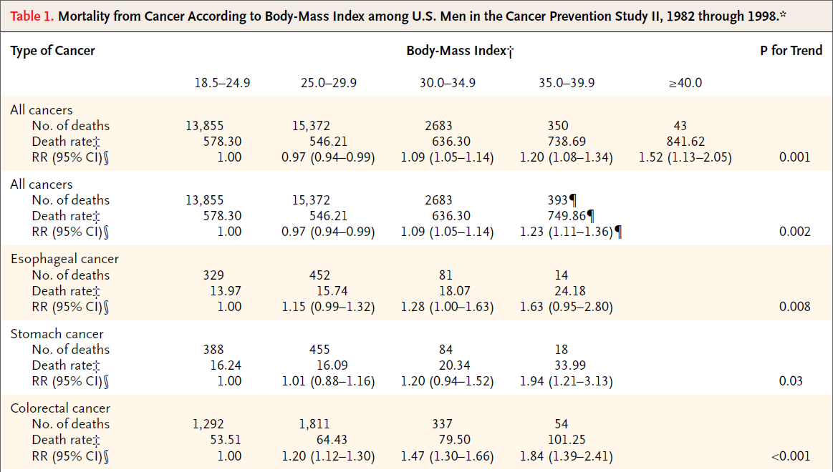
Overweight, Obesity, and Mortality from Cancer in a Prospectively Studied Cohort of U.S. Adults

Slide 23
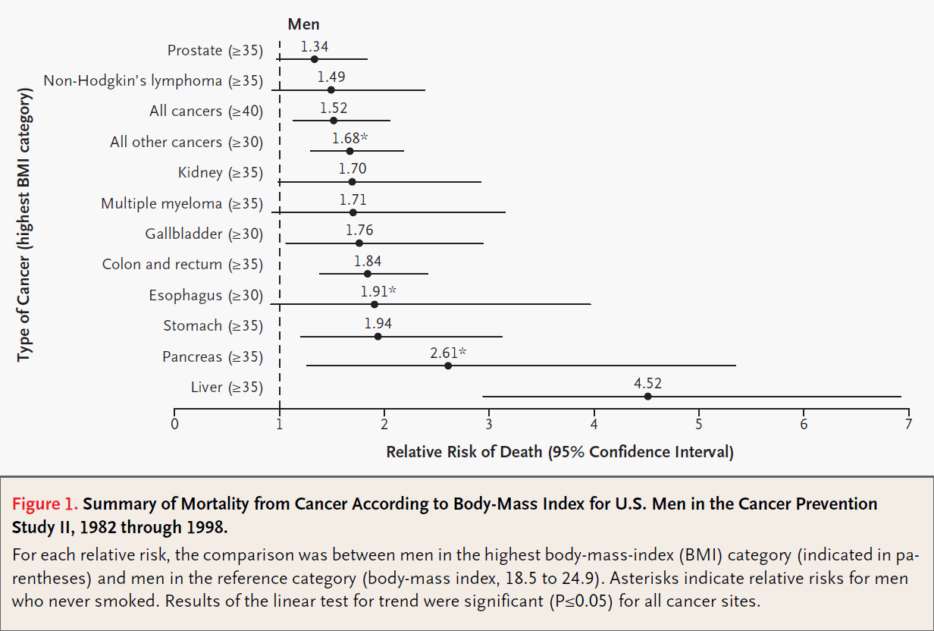
Overweight, Obesity, and Mortality from Cancer in a Prospectively Studied Cohort of U.S. Adults

Slide 24
Motivating Example #2
Study [link]:
Assess the protective effects of community-wide bed net use
  i.e., estimate the association between proportion of a community using LLINs and malaria in children

Slide 25
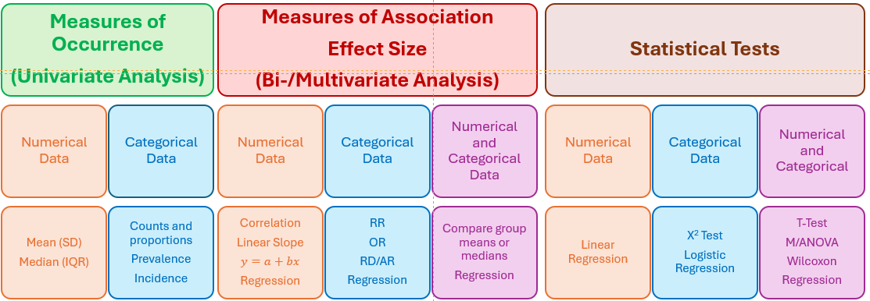
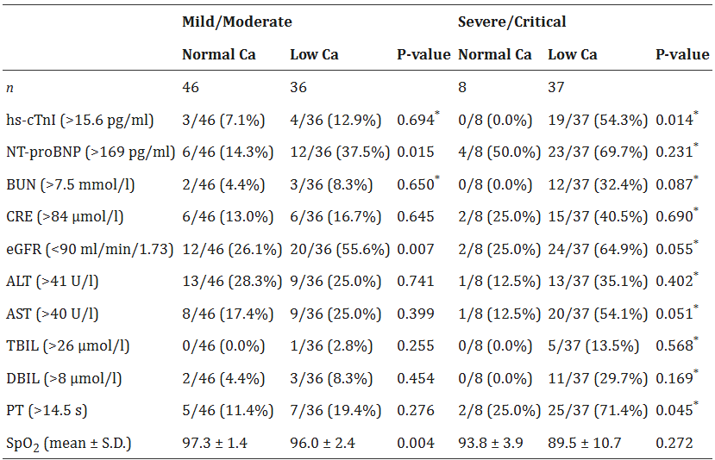
Cross-Tabulations

Slide 26
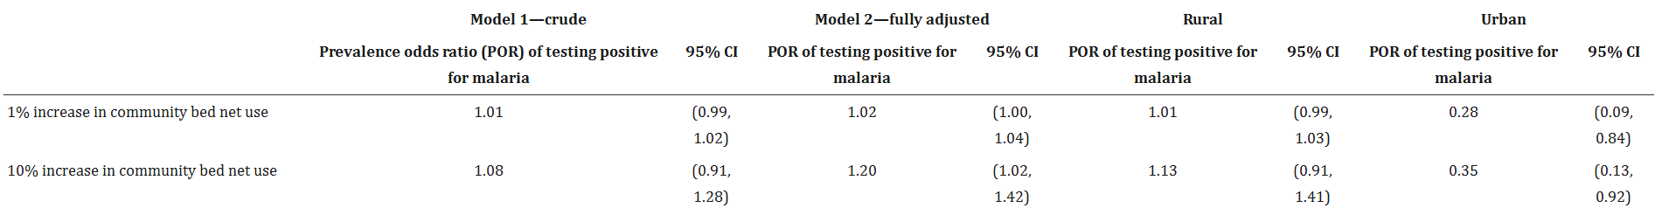
Cross-Tabulations

Slide 27


Thank you!
Email: mtalbirair@gmail.com
LinkedIn: https://www.linkedin.com/in/mohamed-albirair-0206bbb2/

